Slide 1

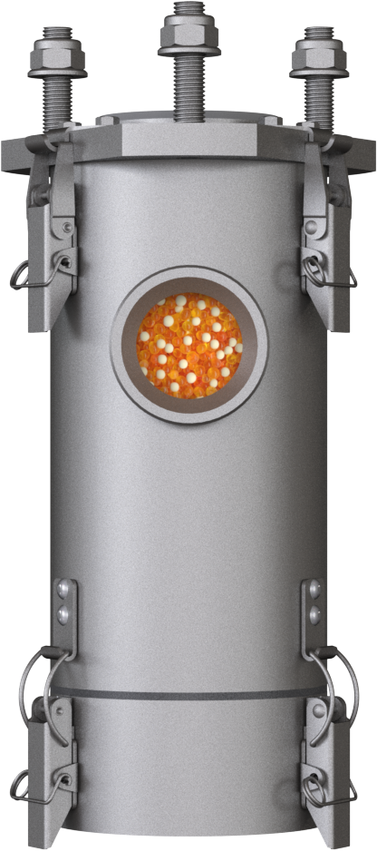

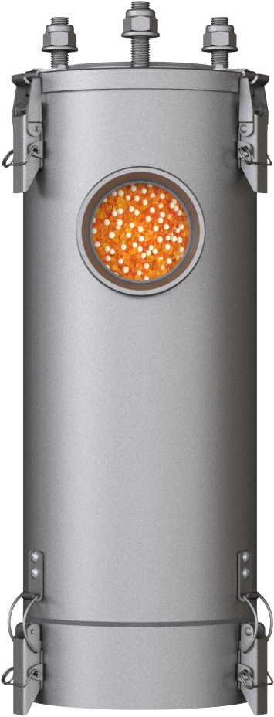
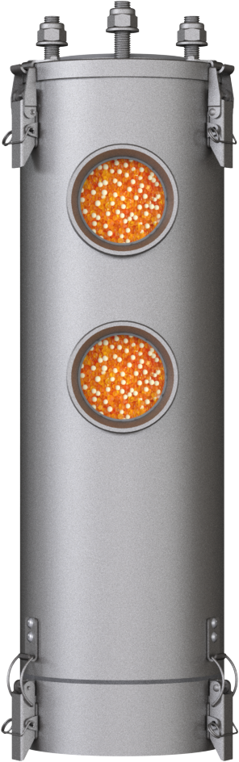
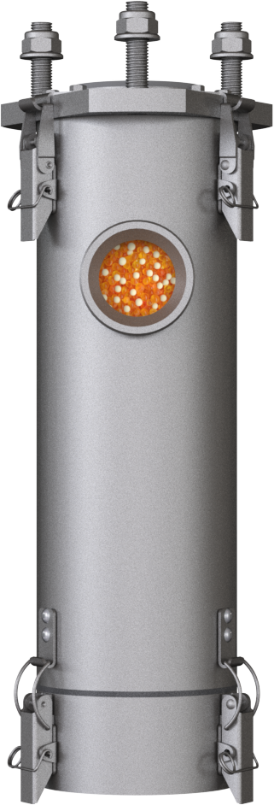
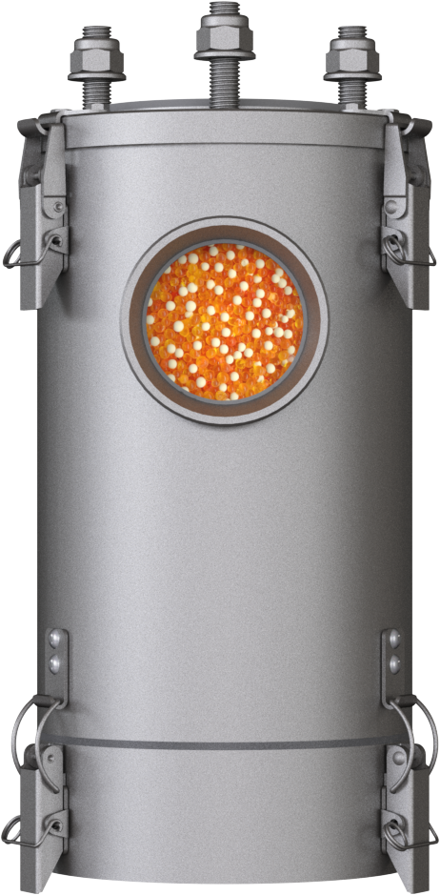
ADSORBER TM-RV
TM-RV | Version 4-2024
Page 1/3
Cost-Effective Maintenance | Extended Maintenance Interval | For ATEX Zones & Offshore
GIEBEL Adsorbers® of the TB-RV series are specially developed for the ventilation of transformers. They are made entirely of A4 stainless steel. The optimised design enables a fast and at the same time cost-effective maintenance. The separate valve part extends the maintenance interval considerably and is suitable for all standard connections.
Suitable for transformers.
 | TM-RV 3M | TM-RV 3L | TM-RV 5M | TM-RV 5L | TM-RV 5XL
Total Weight [lb] | 12,56 | 14,99 | 21,16 | 25,35 | 16,97
GIEBEL Xdry® [lb] | 2,42 | 3,30 | 5,73 | 7,93 | 10,14
Color-change capacity [fl.oz.] | 13,01 | 19,54 | 30,77 | 42,60 | 54,44
Height [inch] | 11¹/₁₆" | 15" | 12¹/₈" | 16¹/₈" | 20"
Diameter [inch] | 4¼“ - 5⁷/₈" | 4¼“ - 5⁷/₈" | 5⁷/₈“ - 7¹/₈" | 5⁷/₈“ - 7¹/₈" | 5⁷/₈“ - 7¹/₈"
Connection | DIN42562, DIN42567C | DIN42562, DIN42567C | DIN42562 | DIN42562 | DIN42562
Valves [IN-OUT] | 1 - 1 | 1 - 1 | 2 - 2 | 2 - 2 | 2 - 2
GIEBEL FilTec Inc.
470 Commerce Drive, Suite 668, Peachtree City, GA,30269
(+1) 943-257-8221
Info.us@gf-dry.com www.giebel-adsorber.com

Slide 2
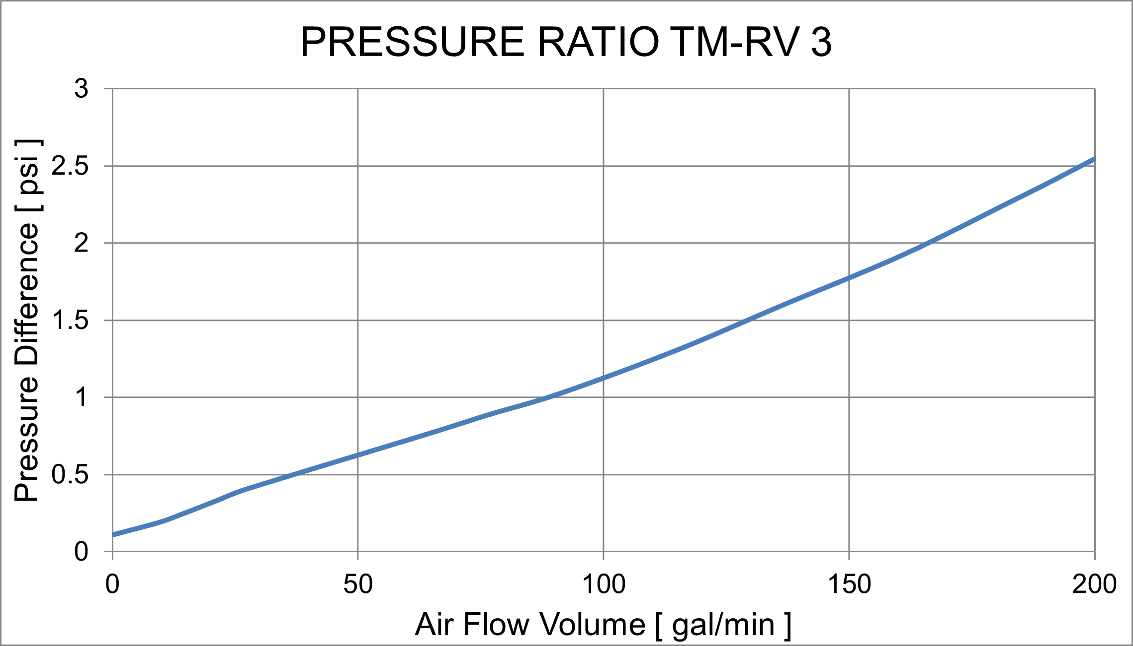
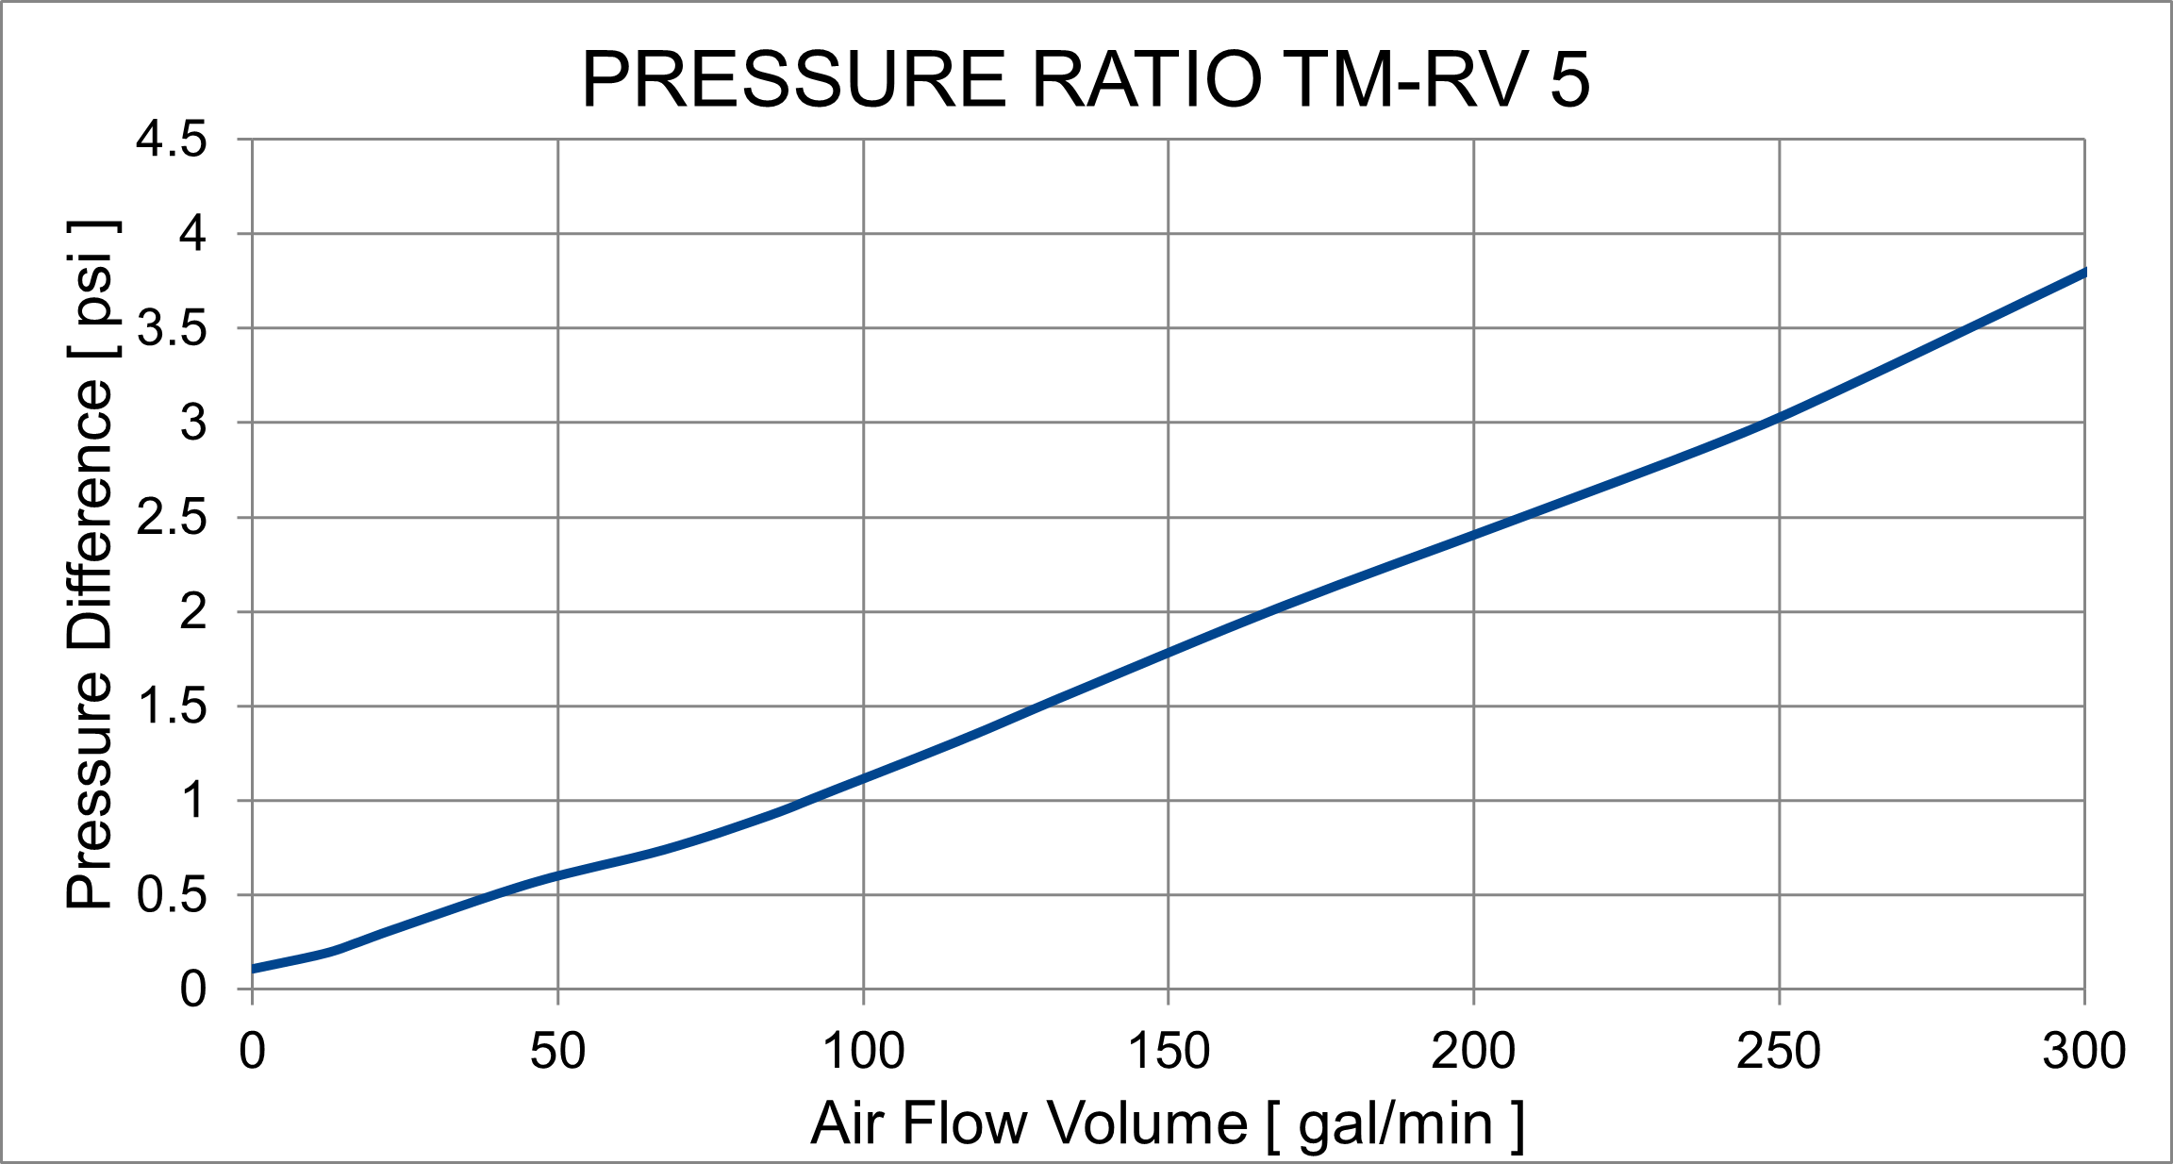
TM-RV | Version 4-2024
Page 2/3
Use | Drying of supply air
Material | Stainless steel A4, FKM, GIEBEL Xdry®, activated carbon
Substance | Transformer oil, Insulating oils
Refillable | Yes
Application ATEX 2014 | Yes
Offshore suitable | Yes
Adsorbent quantity | 2,42 – 10,14lb (GIEBEL Xdry®)
Valves | Yes
IP protection class | IP 66
UV resistance | Very High
Temperature range | -40°F ... 176°F / 320°F
Corrosivity class | CX „High“
REACH comliant | Yes
RoHS compiant | Yes
Customs tariff number / Country of origin | 84213925 / Germany
GIEBEL FilTec Inc.
470 Commerce Drive, Suite 668, Peachtree City, GA,30269
(+1) 943-257-8221
Info.us@gf-dry.com www.giebel-adsorber.com

Slide 3
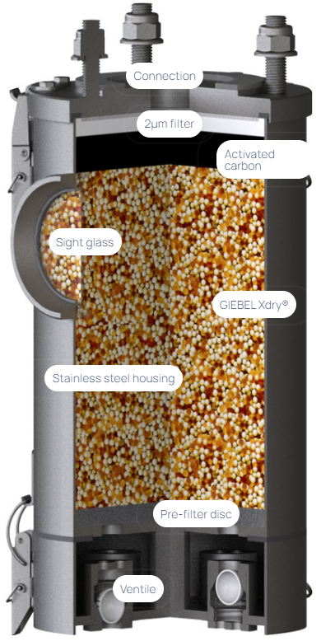

TM-RV | Version 4-2024
Page 3/3
MORE INFORMATION
More about our adsorber series, accessories and spare parts, as well as data sheets for download on www.giebel-adsorber.com.
GIEBEL FilTec Inc.
470 Commerce Drive, Suite 668, Peachtree City, GA,30269
(+1) 943-257-8221
Info.us@gf-dry.com www.giebel-adsorber.com

